Slide 1
Games Network Database
Presented by Zach Baccaro, Jesse Beach, Stryder R. Coleman, Emily Hampston, and Brandon Marcellette

Slide 2
Statement of Objectives
The project goal is to design a database for a game network; that can facilitate the functions needed for a large network. The database should be able to host users, games, store listings, and achievements, as well as allowing for users to own games, add friends, and earn achievements. It should be able to display information about all entities within the database.

Slide 3
Requirements
The database must allow users to have profiles.
The database must make a distinction between users and developers.
The database must provide functions that allow users to send messages to each other.
The database must provide functions that allow users to earn achievements.
The database must provide functions that allow users to friend other users.
The database must allow users to own games.
The database must not allow users under 18 to own M rated games.
The database must contain records of games owned by users in their game library.
The database must support a store that has games listed to it.
The database must allow games to exist, but are not listed to the store.
The database must allow users to own games.

Slide 4
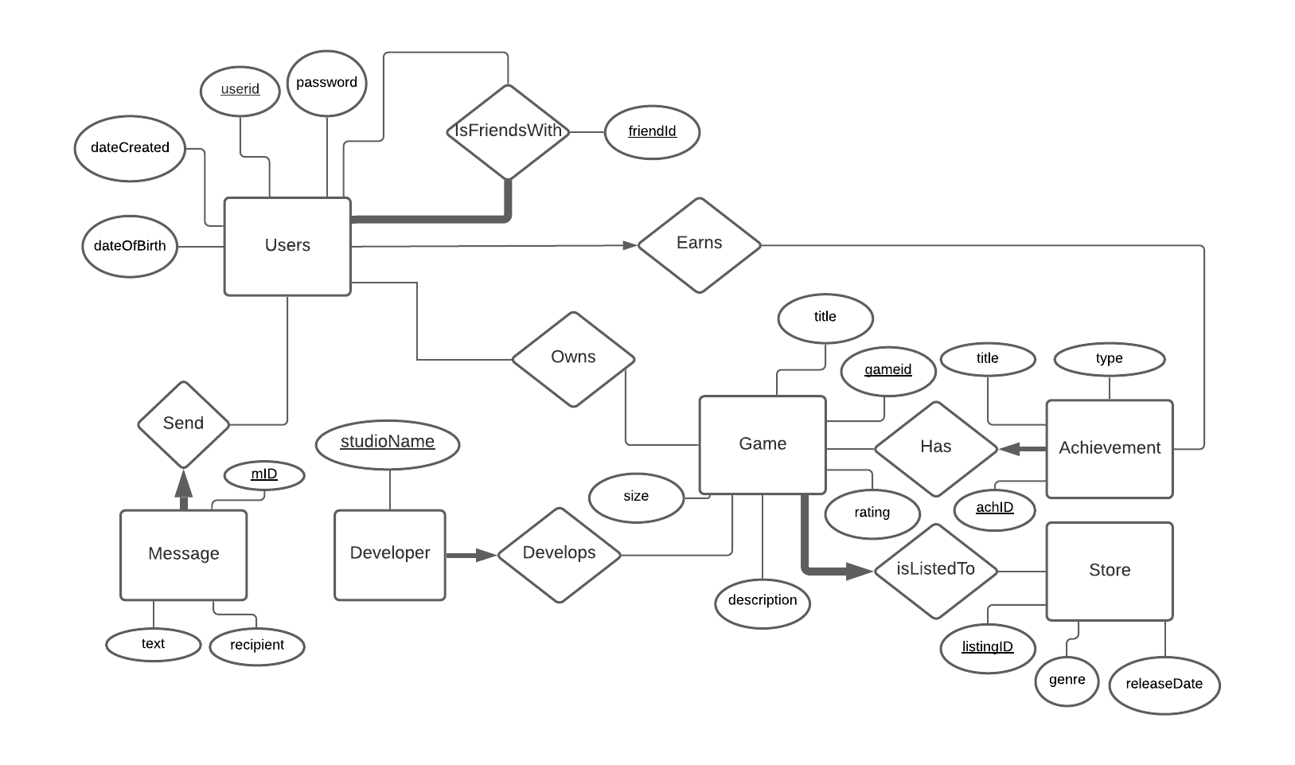
ER Diagram

Slide 5
SQL Schema
CREATE TABLE Users(
userid CHAR(60), password CHAR(50),
dateCreated date default getDate() check(dateCreated < getDate()),
sex CHAR(1) check (sex in('M','F', 'O')),
dateOfBirth DATE check(dateOfBirth < getDate()),
PRIMARY KEY(userid));
CREATE TABLE Developer(
studioName CHAR(60),
PRIMARY KEY (studioName))
CREATE TABLE Game(
listingid INTEGER,
title CHAR(100),
description CHAR(255),
size DOUBLE,
rating CHAR(1) check(rating in('E', 'T', 'M')),
PRIMARY KEY(listingid))
CREATE TABLE Store(
listingid INTEGER,
genre CHAR(20) check(genre in('Action', 'Sports', 'Strategy', 'RPG', 'Adventure')),
releaseDate DATE,
PRIMARY KEY(listingid),
FOREIGN KEY(listingid) REFERENCES Game(listingid)
ON DELETE RESTRICT)
CREATE TABLE Message(
mId INTEGER,
userid CHAR(60),
recipient CHAR(60),
text CHAR(255),
PRIMARY KEY (mId),
FOREIGN KEY(userid) REFERENCES User(userid),
FOREIGN KEY(recipient) REFERENCES User(userid))

Slide 6
SQL Schema
CREATE TABLE Earns(
userid CHAR(60),
achID INTEGER,
PRIMARY KEY(userid, achID),
FOREIGN KEY(userid) REFERENCES User (userid),
FOREIGN KEY(achID) REFERENCES Achievement (achID))
CREATE TABLE isFriendsWith( userid CHAR(60), friend char(60), PRIMARY KEY(userid, friend), FOREIGN KEY(userid) REFERENCES Users (userid), FOREIGN KEY(friend) REFERENCES Users(userid), check(userid <> friend))
CREATE TABLE Develops(
studioName CHAR(60),
listingid INTEGER,
PRIMARY KEY(studioName, listingid),
FOREIGN KEY(listingid) REFERENCES Game (listingid),
FOREIGN KEY(studioName) REFERENCES Developer(studioName))
CREATE TABLE Achievement(
achID INTEGER,
title CHAR(100),
type CHAR check(type IN(‘Bronze’, ‘Silver’, ‘Gold’)),
PRIMARY KEY(achID))
CREATE TABLE Has(
achID INTEGER,
listingid INTEGER,
PRIMARY KEY(achID, listingid),
FOREIGN KEY(achID) REFERENCES Achievement(achID),
FOREIGN KEY(listingid) REFERENCES Game(listingid))
CREATE TABLE Owns(
userid CHAR(60),
listingid INTEGER,
PRIMARY KEY(userid, listingid),
FOREIGN KEY (userid) REFERENCES User(userid),
FOREIGN KEY (listingid) REFERENCES Game(listingid))

Slide 7
Queries
INSERT INTO User(userid, password, dateCreated, sex, dateOfBirth) VALUES('user1', 'password', '2020-11-23', ‘F’, 2000-1-5');
INSERT INTO `isFriendsWith`(`userid`, `friend`) VALUES ('User1', 'user2');
INSERT INTO `Game`(`listingid`, `title`, `description`, `size`, `rating`) VALUES ('1', 'COD', 'FPS', '50', 'M');
INSERT INTO `Achievement`(`achID`, `title`, `type`,) VALUES ('1', 'Legendary', ‘Gold’);
INSERT INTO `Earns`(`userid`, `achID`) VALUES ('User1', '1');
INSERT INTO `Message`(`mId`, `userid`, `recipient`, `text`) VALUES ('1', 'User1', 'User2', 'Hello');
INSERT INTO `Store`(`listingid`, `genre`, `releaseDate`) VALUES ('1', 'Action', '2020-12-31');
INSERT INTO `Developer`(`studioName`) VALUES ('Studio1');
INSERT INTO `Develops`(`studioName`, `listingid`) VALUES ('Studio1', '1');
INSERT INTO `Owns`(`userid`, `listingid`) VALUES ('User1', '1');

Slide 8
Triggers
CREATE TRIGGER ageCheck ON Owns
AFTER INSERT
AS
IF(((select rating from game where listingid = NEW.listingid) = 'M') AND ((select dateOfBirth from user where userid = NEW.userid) >= getdate()-18))
BEGIN
ROLLBACK;
END;

Slide 9
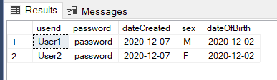


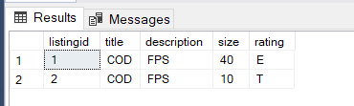
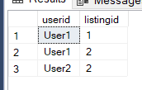
SQL Testing

Slide 10
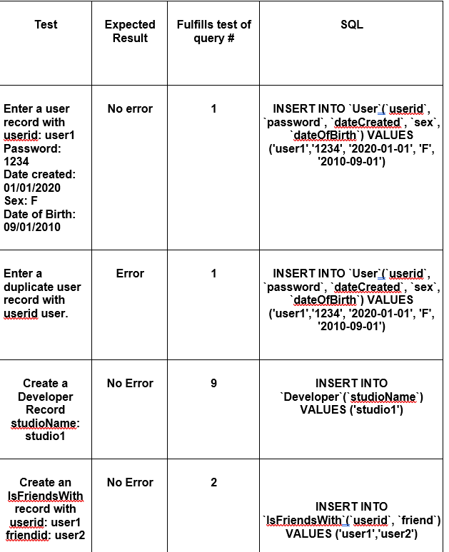
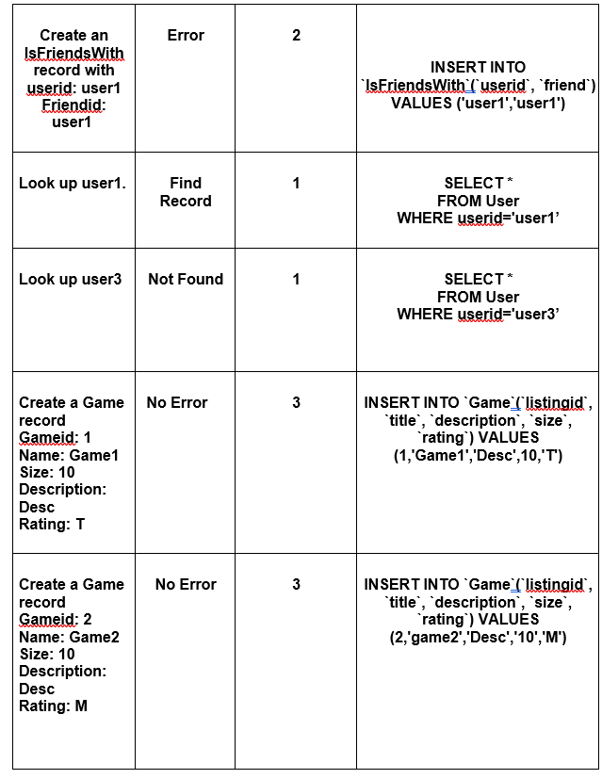

Slide 11
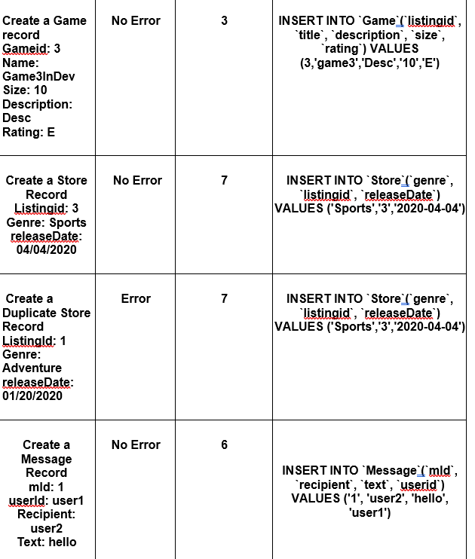
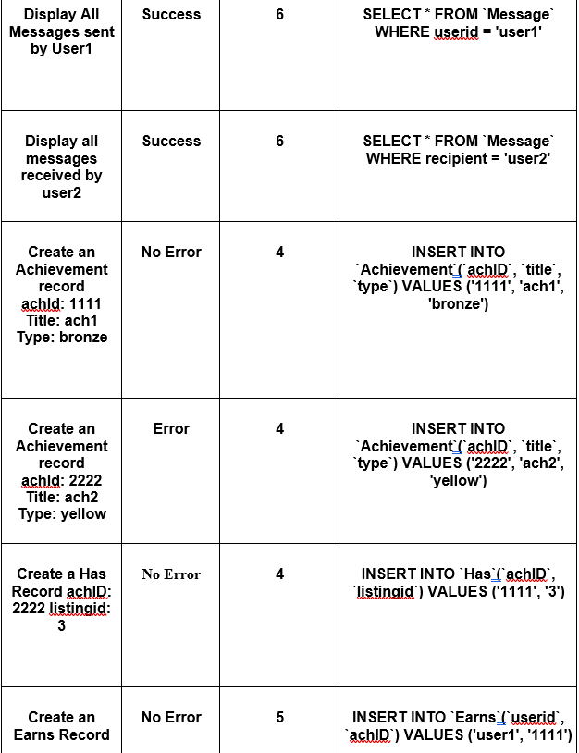

Slide 12
